Slide 1
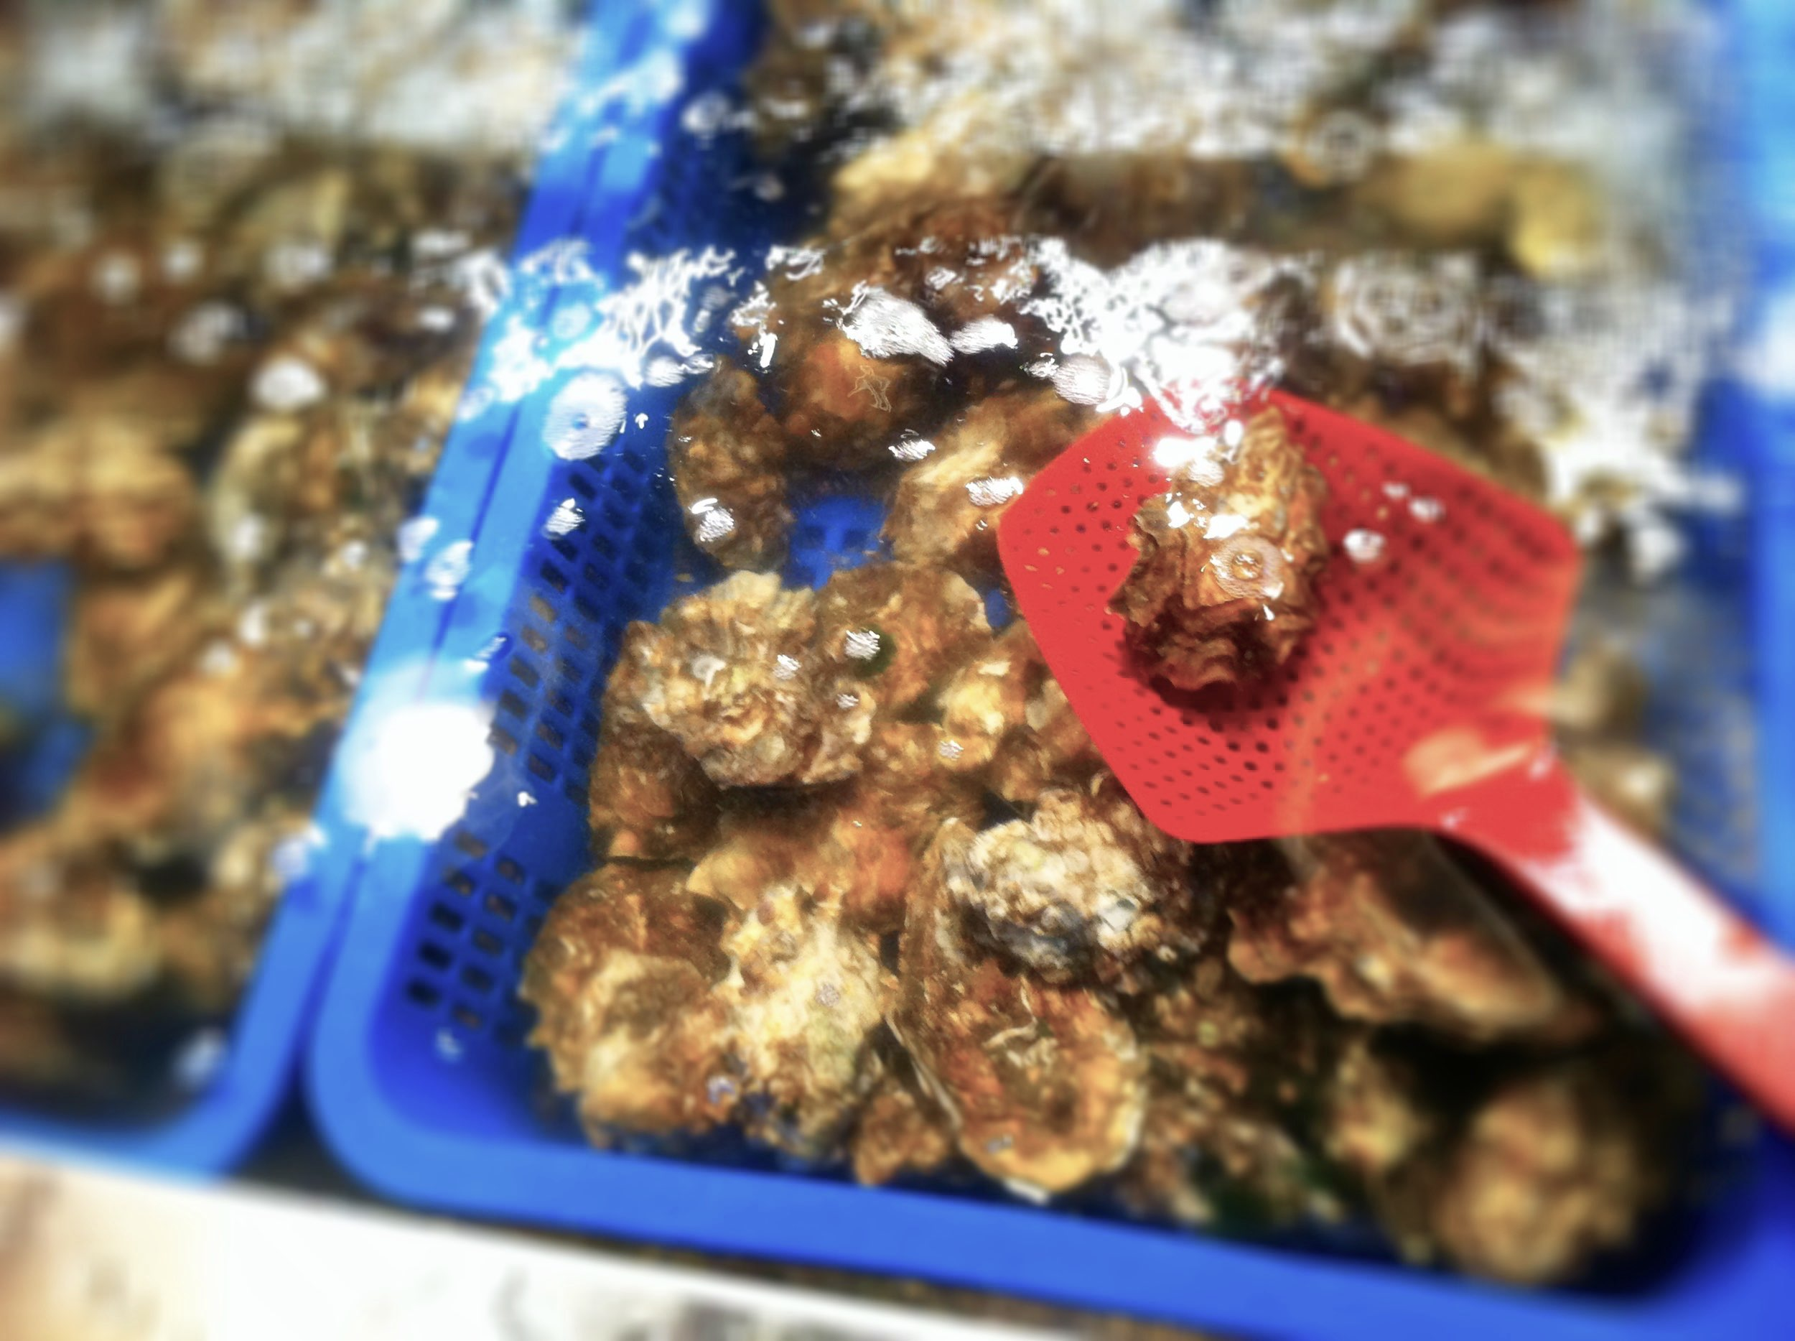
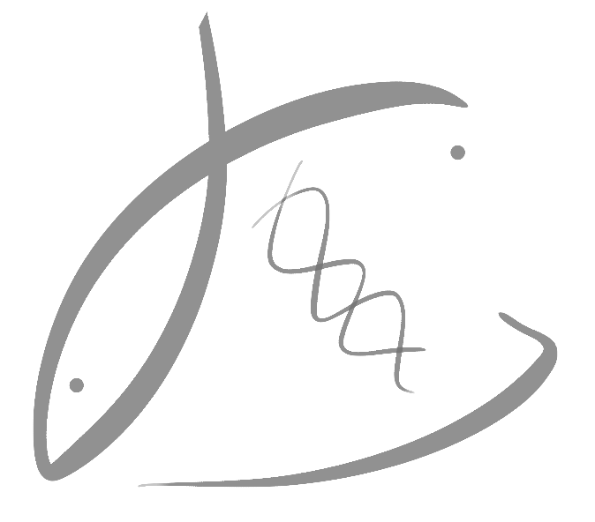
Considering epigenetics in aquatic species culture and conservation
Steven B ROberts
Kenneth K CheW EnDOWED Associate Professor
School of Aquatic and Fishery Sciences

Slide 2
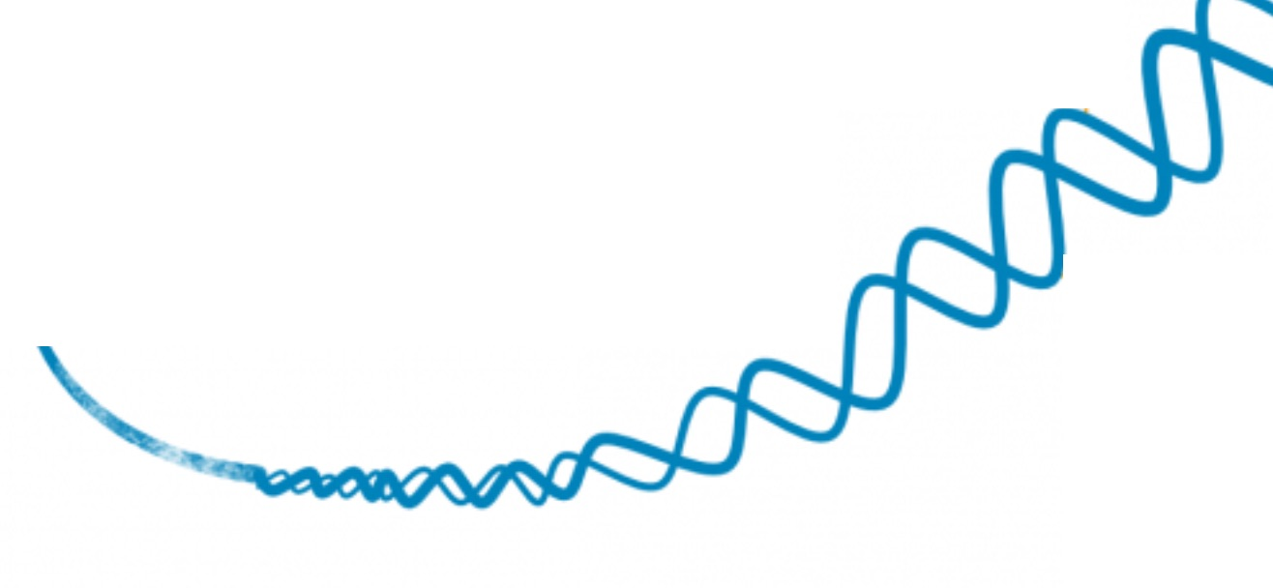
What is EPIGENETICS?
DNA

Slide 3
What is EPIGENETICS?
AlTERS The Phenotype (WITHOUT changing DNA code); HERITABLE

Slide 4
What is EPIGENETICS?
AlTERS The Phenotype (WITHOUT changing DNA code); HERITABLE
Can BE INDUCED WITH ENVIRONMENTAL Manipulation

Slide 5




Aquaculture
Epigenetic Selection
Identifying individuals by attributing trait to epigenotype
Adults
Influencing offspring phenotype by altering environmental conditions of broodstock
Influencing adult phenotype by altering early life environment
Environmental
Manipulation
Larvae

Slide 6
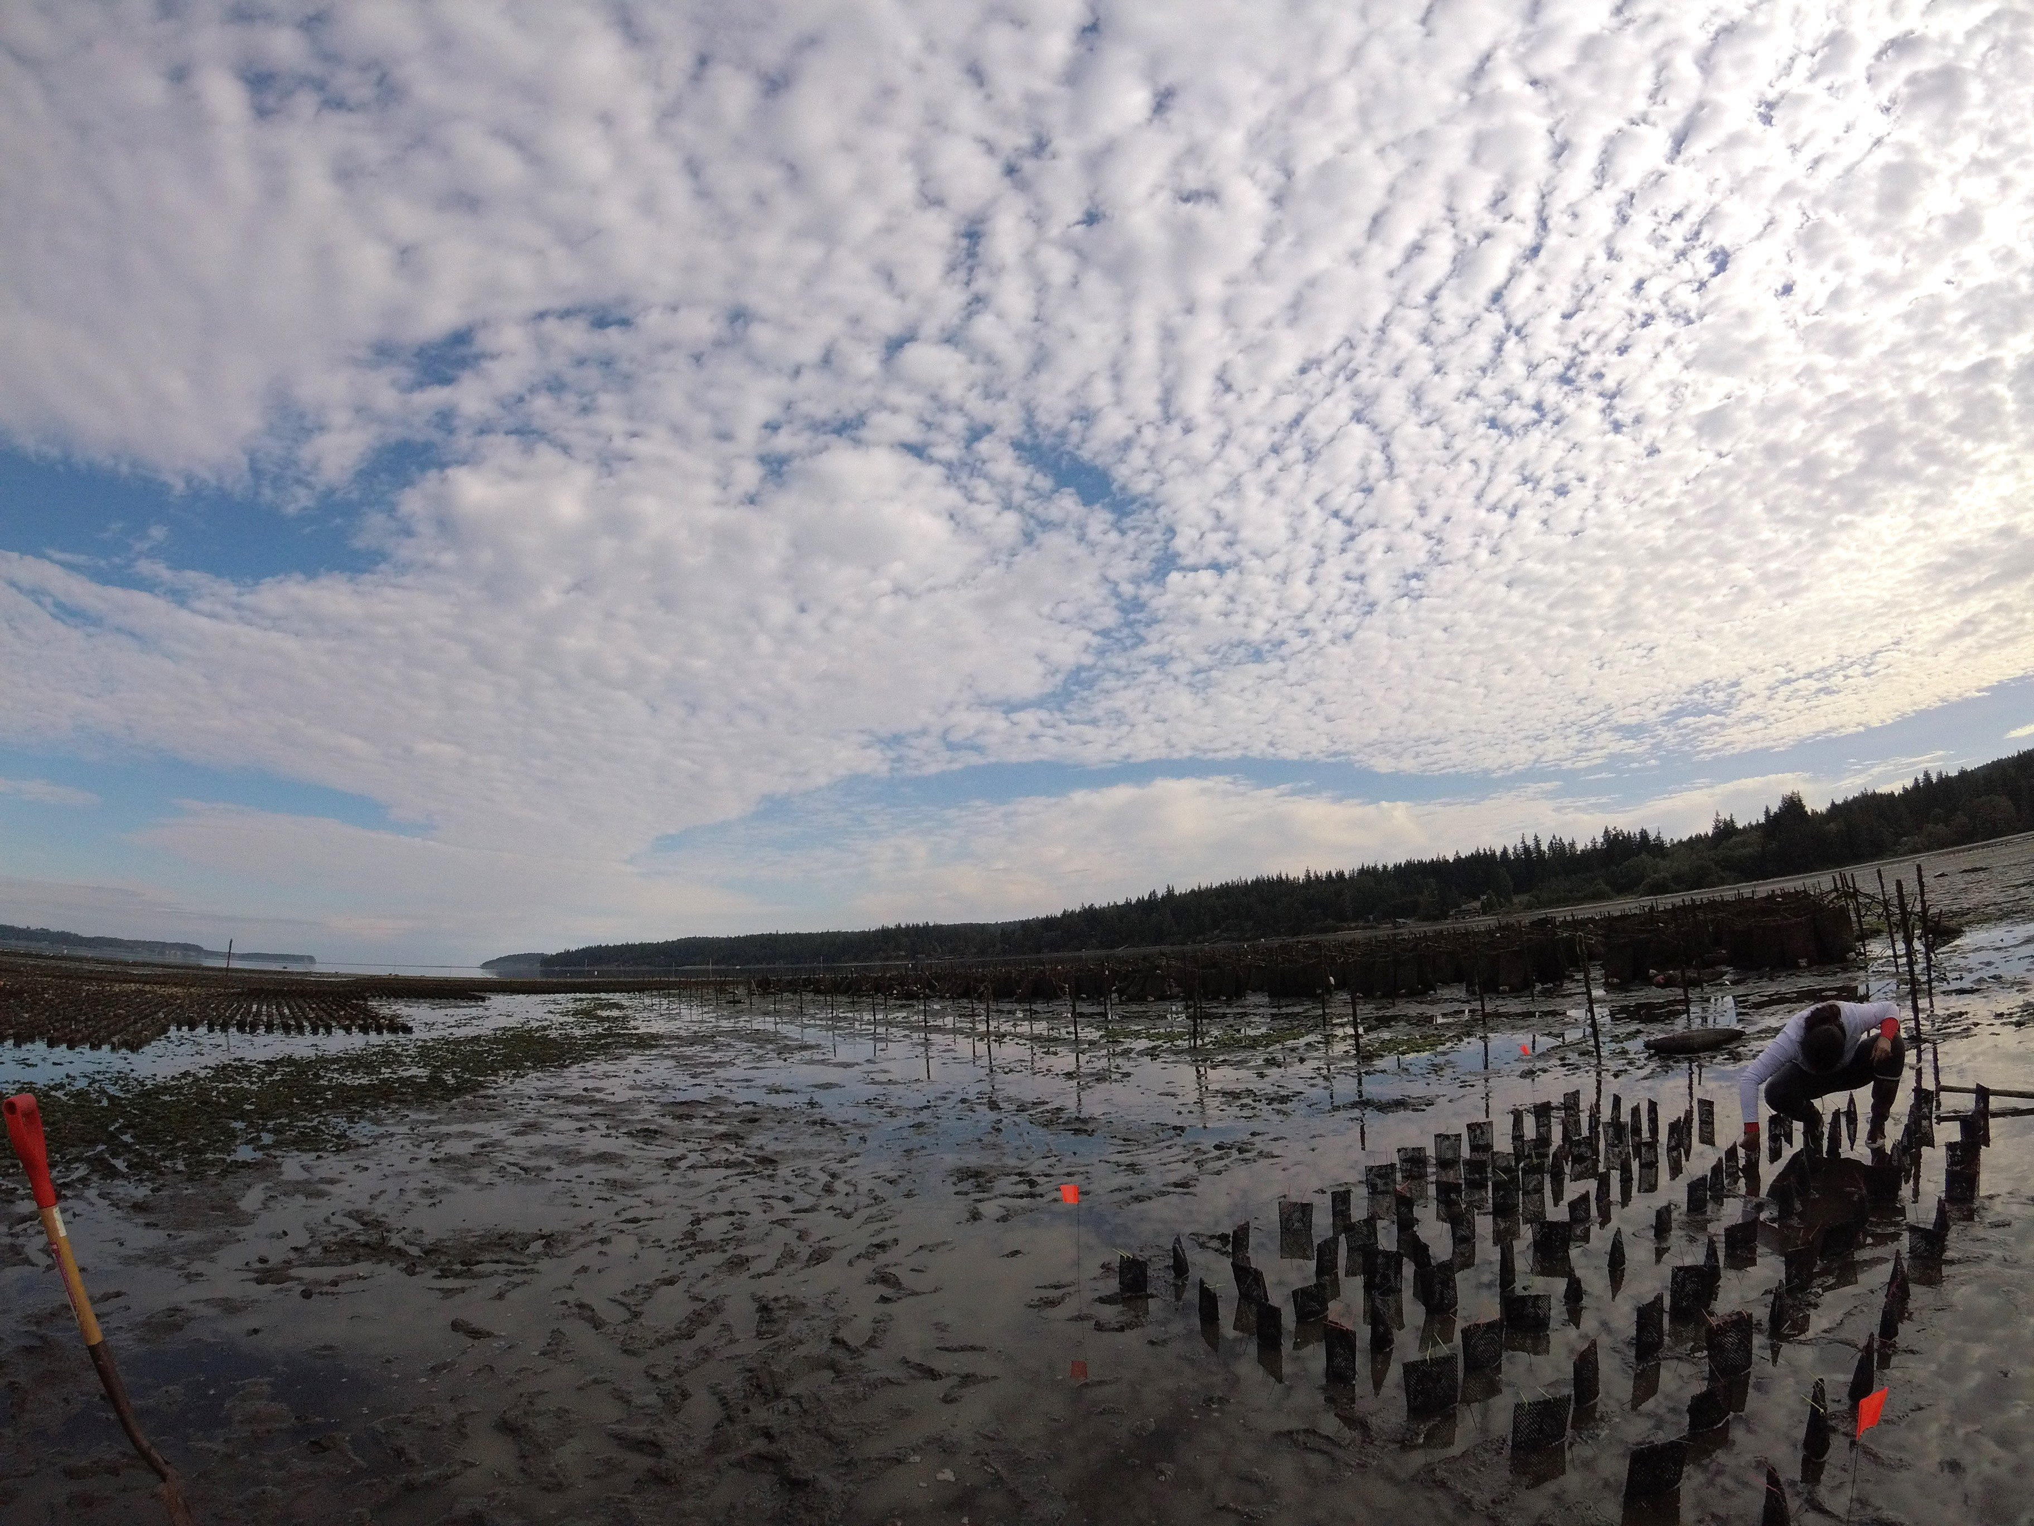
Geoduck Clams & Environmental MEMORY
Aquaculture

Slide 7
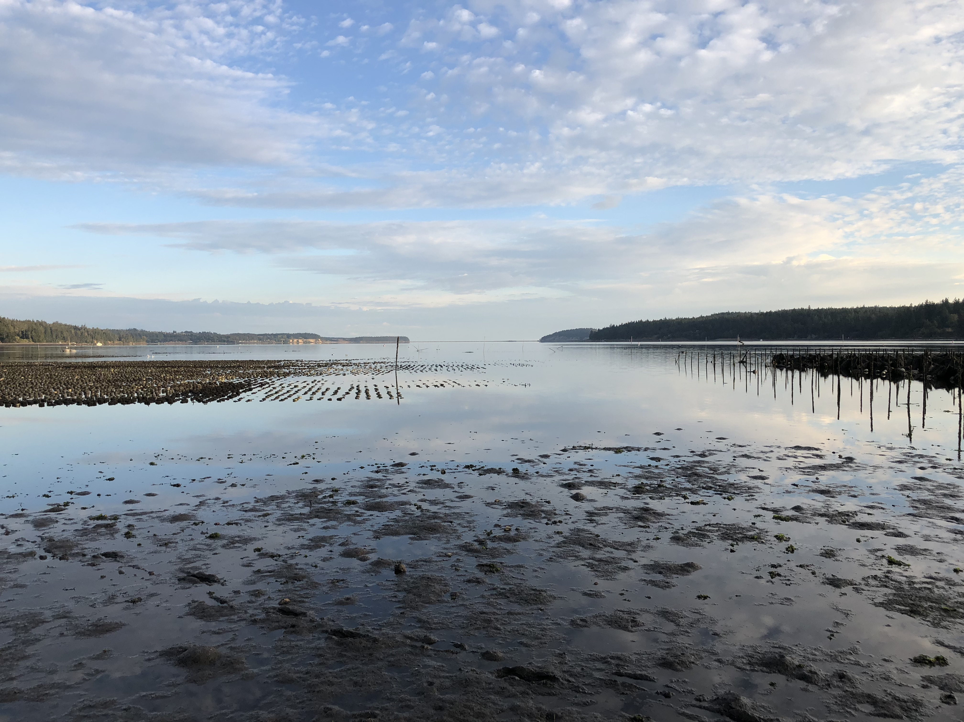
GEODUCK AND Environmental MEMORY
Aquaculture

Slide 8
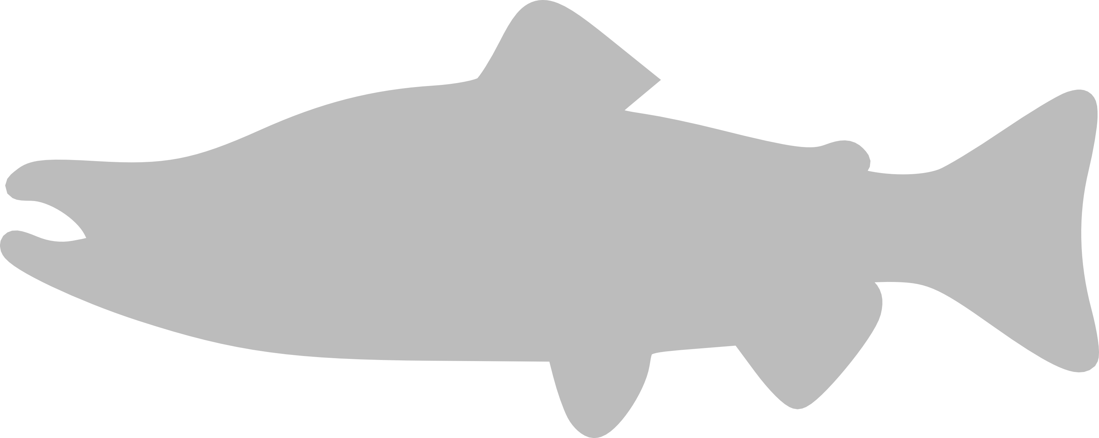
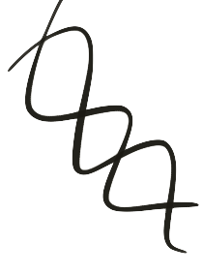
CONSERVATION

Slide 9
CONSERVATION

Slide 10
CONSERVATION

Slide 11

CONSERVATION

Slide 12
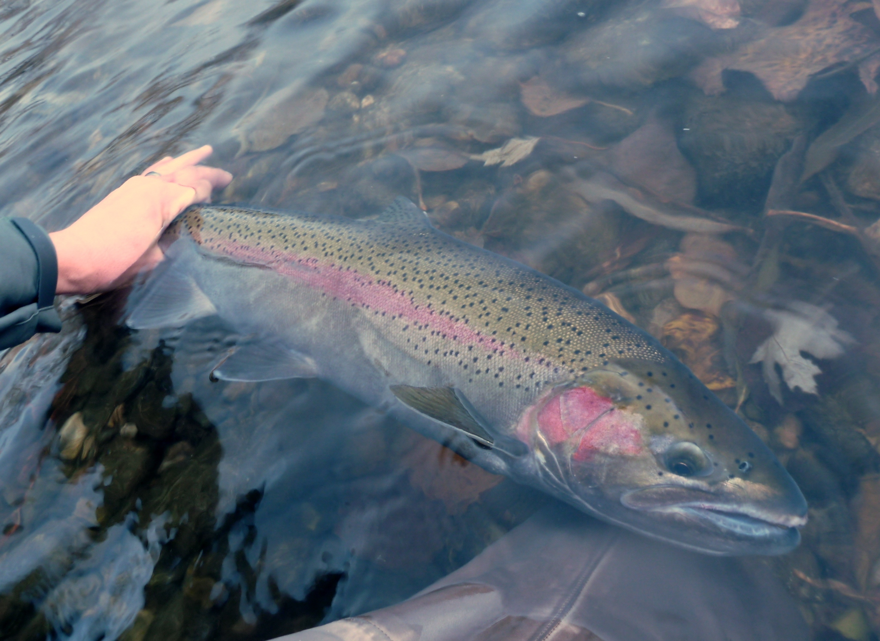
Steelhead Salmon
Conservation
Martin Koenig
Martin Koenig

Slide 13
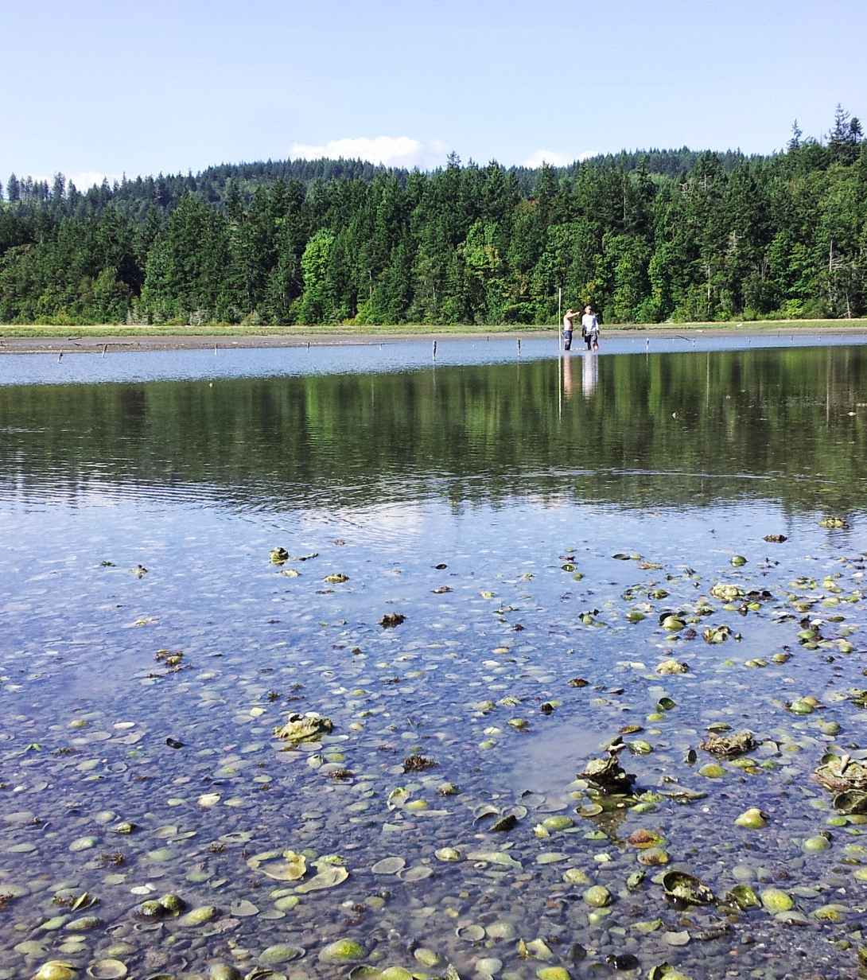
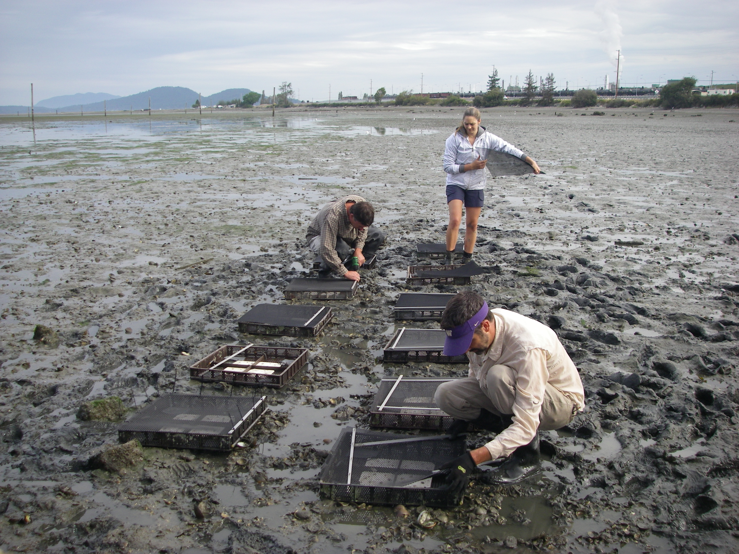
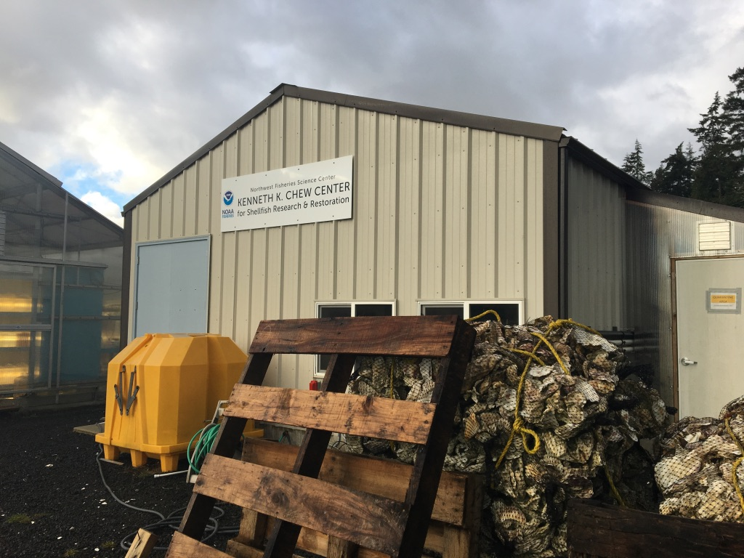
OLYMPIA OYster RESTORATION
CONSERVATION

Slide 14
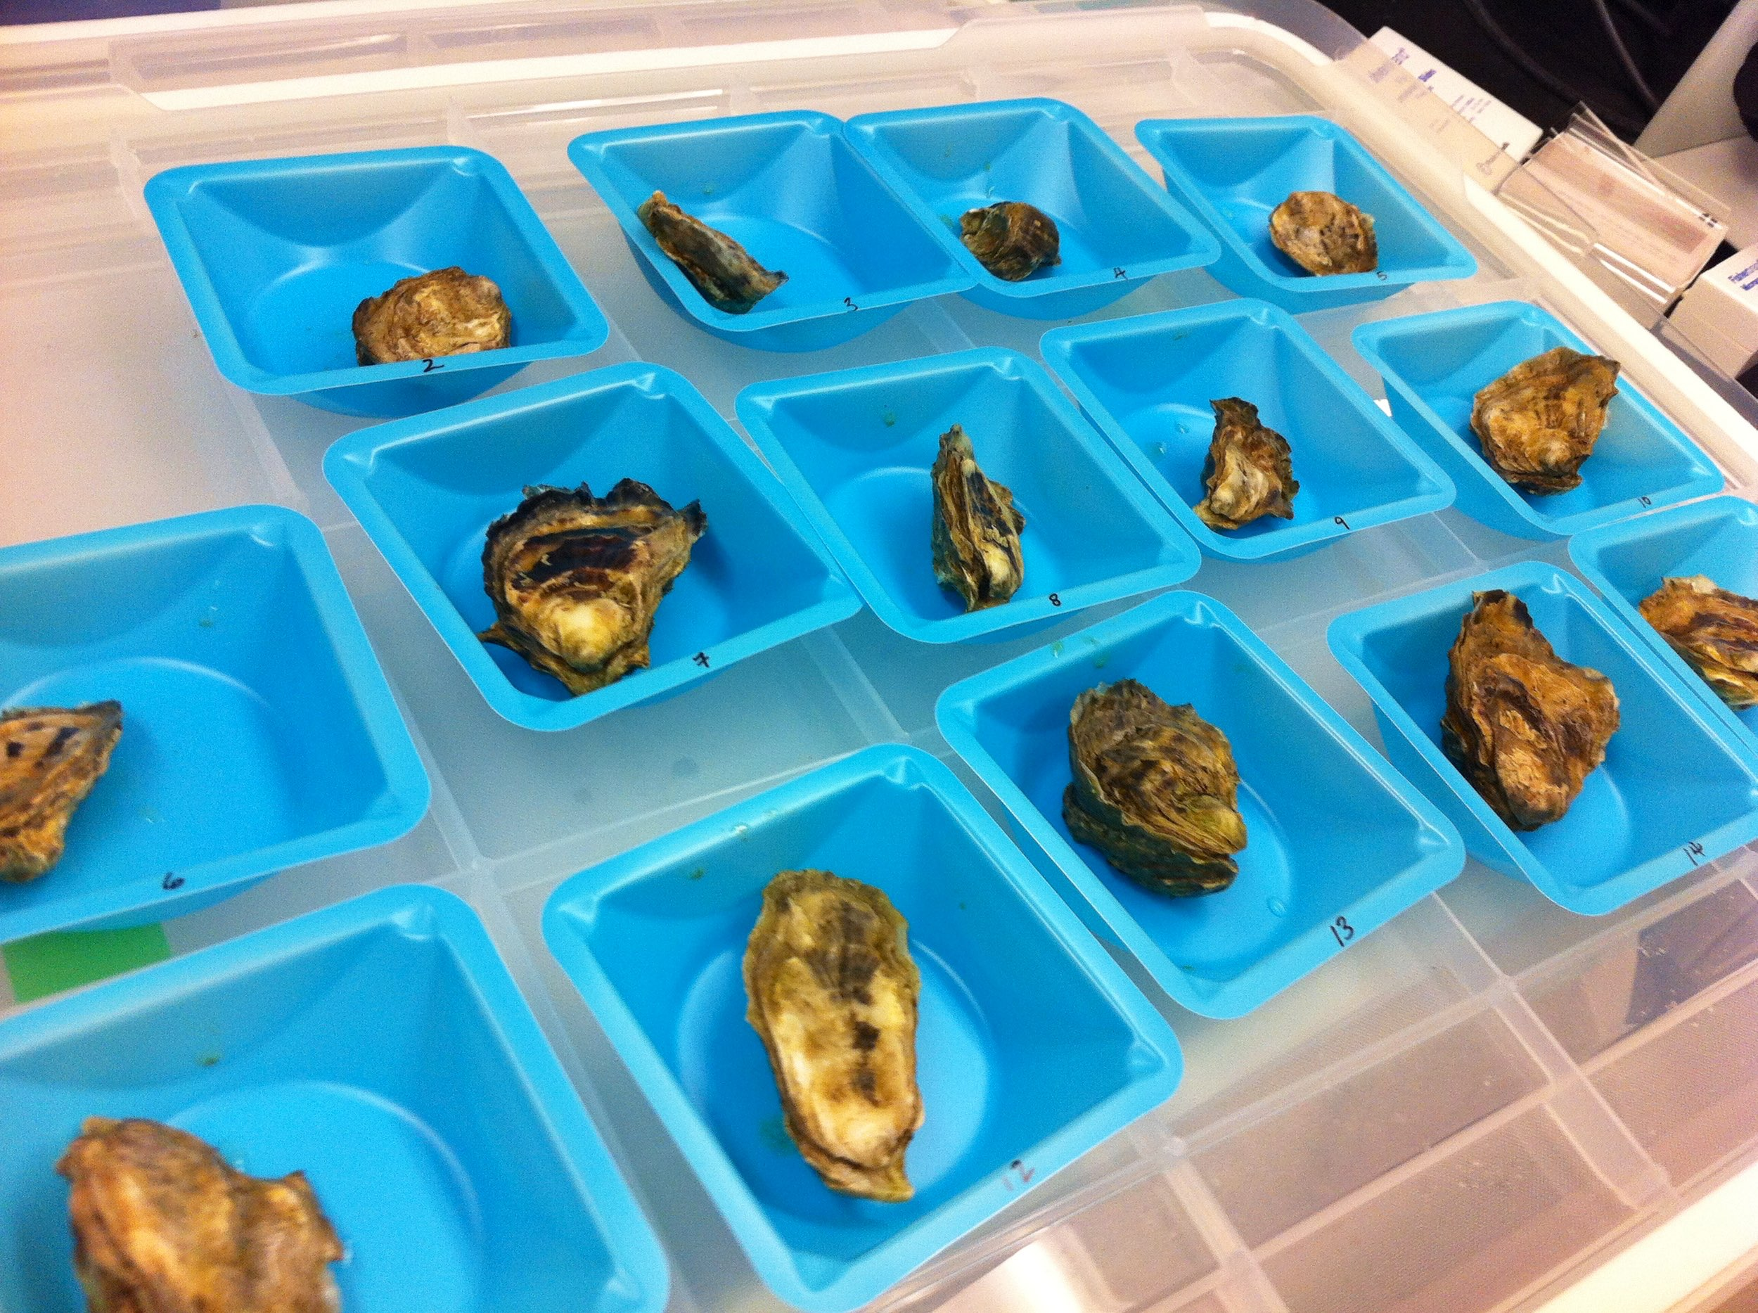


ACKNOWLEDGeMENTS
Considering epigenetics in aquatic species culture and conservation
Mackenzie Gavery, Hollie Putnam, Yaamini Venkataraman, Laura Spencer
Kenneth K. Chew Center for Shellfish Research and Restoration
Jamestown S’Klallam Tribe
Puget Sound Restoration Fund

